Slide 1
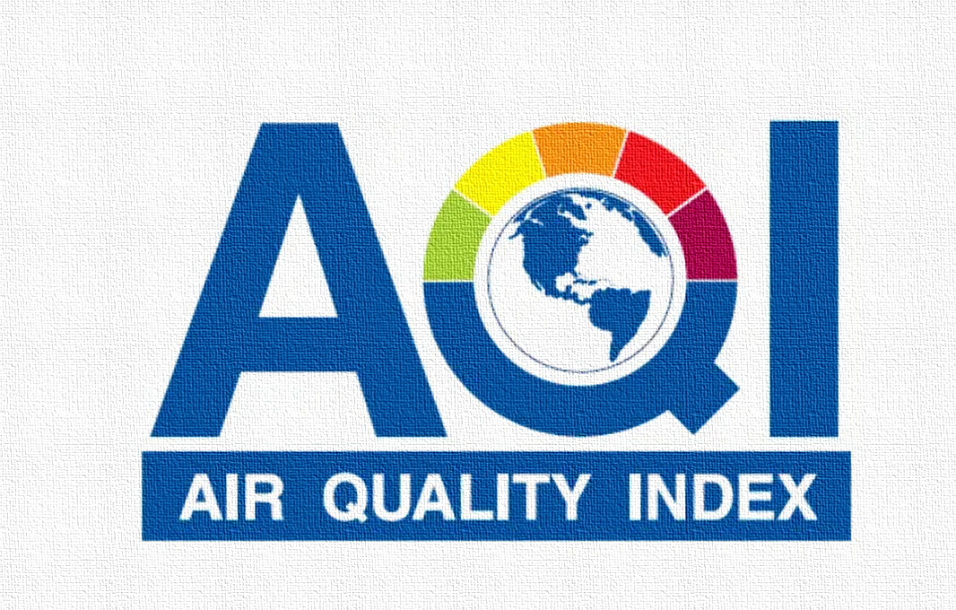
Prediction of AQI with Time Series Forecasting
By:
Vivek Bari
Samruddhi Bhor
Payas Sonkusare
Satish Wagh
Nikhil Shinde
Chetan Palve
Capstone Project Group 1 : DSE_June_23_Pune
Group Mentor : Mr Naveen Kumar Koneti

Slide 2
Capstone Project
1
AQI Project View
Introduction
Problem Statement
List of Algorithms
Visualization, Inferences and Conclusions.
2
3
4
5

Slide 3
INTRODUCTION
Air pollution is a complex mixture of different gases particles perceived as a modern day curse, due to the increased amount of urbanization and industrialization across the world.
Several countries have taken some serious measures to maintain the air quality. India, which holds largest amount of human population, also took various measures to improve the air quality. A report by WHO shows, about 43% of all lung disease and lung cancer are attributable to Air Pollution. As per World Bank study released in 2016 revealed that India lost more than 8.5% of its GDP in 2013 due to the cost of increased welfare and lost labor due to air pollution. Various studies performed previously on the Air quality shows the Particulate Matters (PM2.5 and PM10) as the most dangerous and life threatening pollutant among the group of pollutants. Particulate matter contributes to approximately 800,000 premature deaths each year.
This analysis explores the factors which are influencing the Air pollution, This will help us analyze the trend in air quality across the years which help us to derive some business solutions. Also we believe that forecasting the air quality of cities helps us to prevent before it impacts our environment.

Slide 4
PROBLEM STATEMENT
As India is developing economy from Industrialization perspective. Development may be good for the nation in terms of GDP and economic gain, but it also has a flipside as more and more industries are being established, they are emitting more smoke, pollutants and Particulate Matter (PM) into the air which is increasing Air pollution. Air Pollution is causing diseases such as Asthma, Lung Cancer and other cardiovascular diseases. Air pollution is being measured by AQI (Air Quality Index) and higher the AQI higher the air pollution. In this project we will analyze the air quality data of major developed/ developing cities in India to find some underlying principles or patterns which will help us in predicting the AQI with the given data. Since this data has been captured at specific intervals over a period of time we will be conducting a Time Series Analysis to predict the AQI of a city at a point in time.

Slide 5
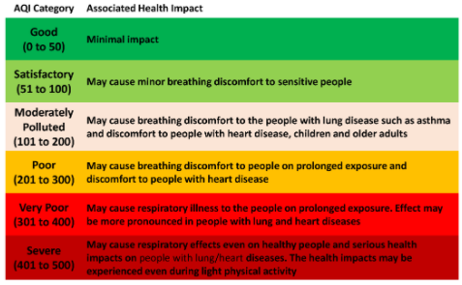
AQI LEVELS

Slide 6
LIST OF ALGORITHMS
ARIMA MODEL
Building Base Model using Univariate Analysis
AUTO ARIMA
Feature Extraction and automatically builds ARIMA MODEL for univariate analysis
VAR(Vector Auto Regression)
LSTM
(Long Short Term Memory)
Multivariate Analysis of the variables to predict the AQI

Slide 7
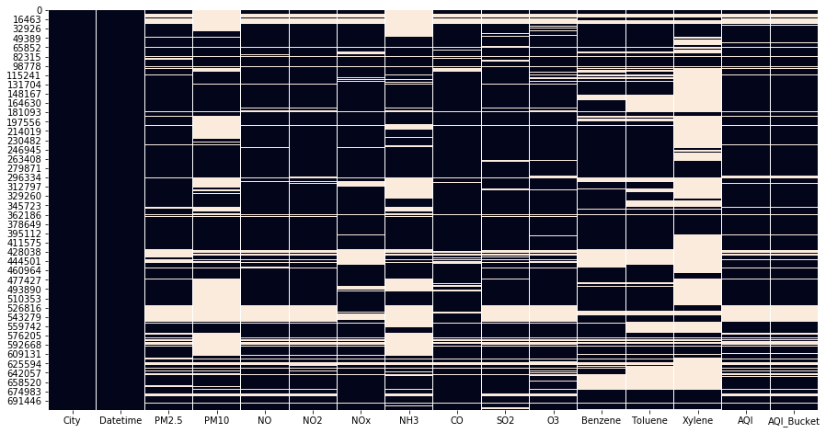
Graph Visualizations Heatmap for missing Values
Columns | % of Missing Values
City | 0
Datetime | 0
PM 2.5 | 20.496
PM 10 | 41.919
NO | 16.476
NO2 | 16.545
NOx | 17.407
NH3 | 38.501
CO | 12.222
SO2 | 18.417
O3 | 18.252
BENZENE | 23.117
TOLUENE | 31.164
XYLENE | 64.393
AQI | 18.234
AQI BUCKET | 18.234

Slide 8
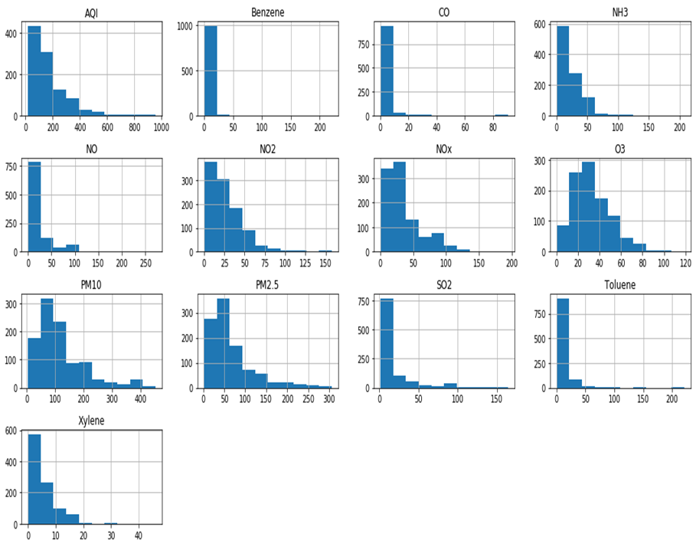
Distribution of Numerical Columns
From the histogram of all numerical columns, most of the variables are skewed.
All the variables are right skewed.
Skewness of the Benzene, Toluene and CO is on higher side then other variables

Slide 9
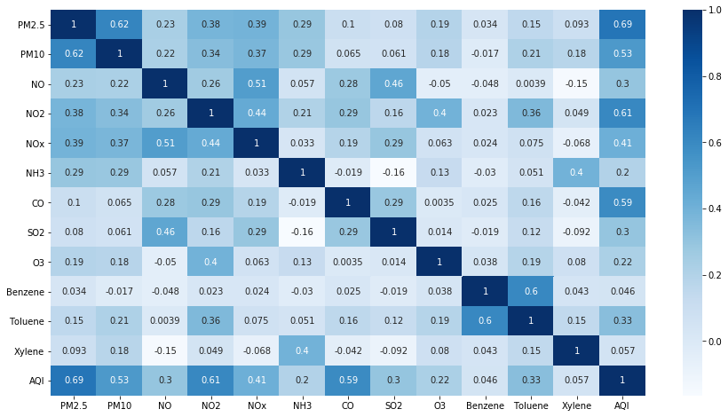
Correlation of Numerical Variables
From the heatmap of correlation, PM2.5, PM10 and CO are having a strong positive correlation with AQI. Which means higher the PM2.5, PM10 and CO Higher the AQI
Other pollutants are having a positive correlation with AQI but it is a weak correlation. Which creates less impact on AQI.

Slide 10
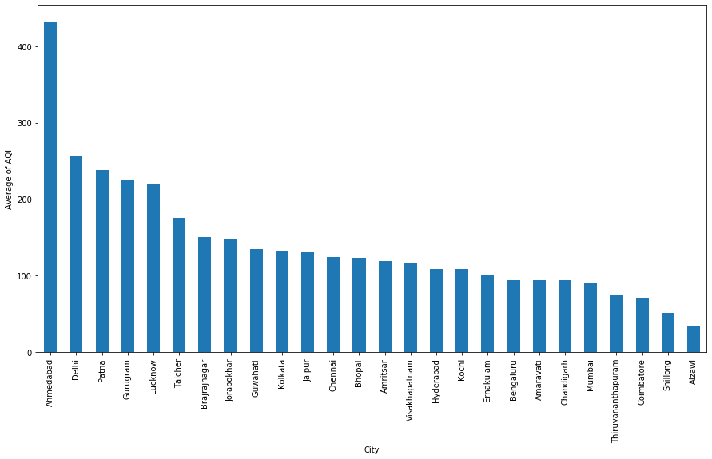
City wise Average AQI
From the plot, Ahmedabad city have a higher average of AQI in last 5 years.
And Aizawl have very low no of AQI may be the reason for that is mountainous area.

Slide 11
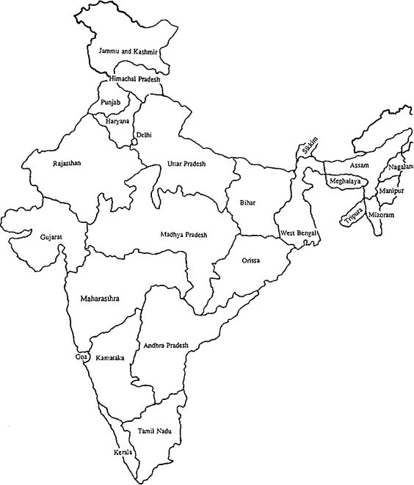
GURGAON
CITYWISE REPRESENTATION OF AQI ON MAP OF INDIA
DELHI
LUCKNOW
PATNA
SHILLONG
AIZWAL
AHMEDABAD
According to the map we can see the top 5 cities with the highest AQI and top 5 cities with the lowest AQI
Cities with the highest AQI are represented by the red marker and the cities with the lowest AQI are represented by the green marker.
According to this map we can infer that places towards the north region have high AQI where as the AQI falls as we come down south.
Ahmedabad is the city with the highest AQI and Aizwal has the lowest AQI
MUMBAI
COIMBATORE
THIRUVANATAPURAM

Slide 12
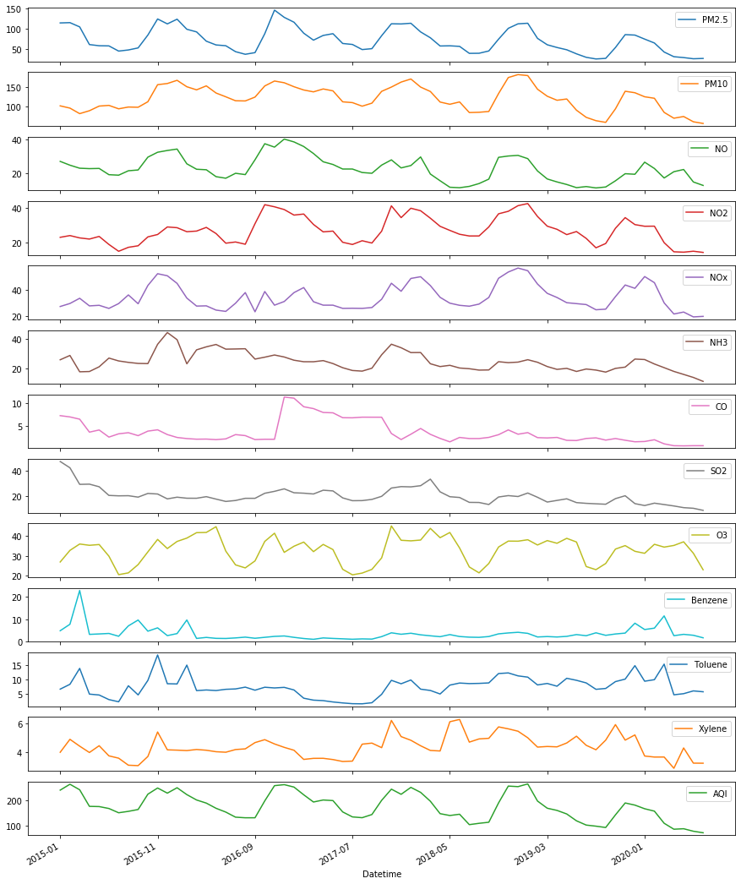
Visualize Time Series Data by Month wise
Inferences of the Graph
From the month wise visualization of all pollutants, AQI is decreases after January 2020, possibly due to Covid pandemic.
Most of pollutants are also decreases after January 2020.

Slide 13
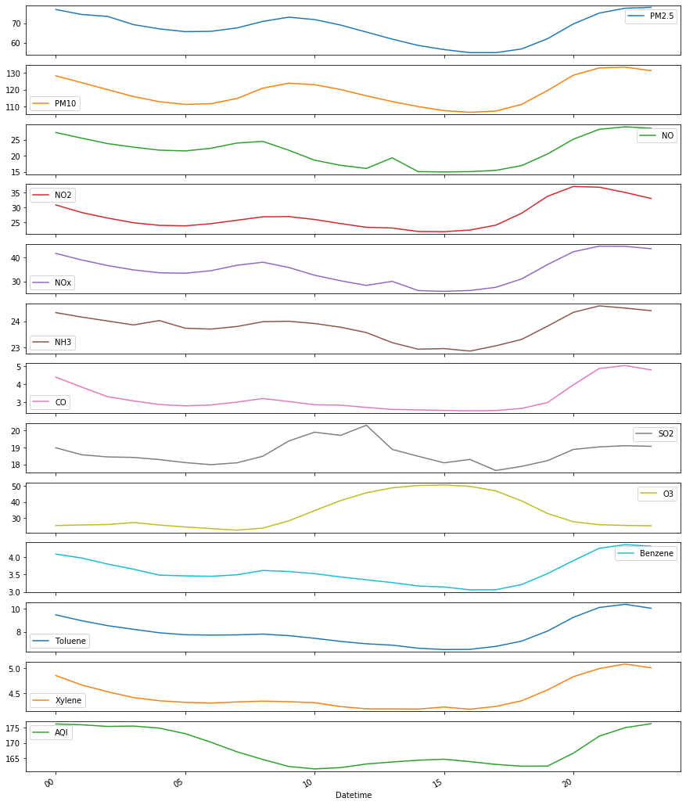
Visualize Time Series Data Hour wise
Inferences of the graph
From the plot of all pollutants hour wise, can say that the AQI is high during night and low at mid day.
All other pollutants are also high during night and low at mid night.

Slide 14
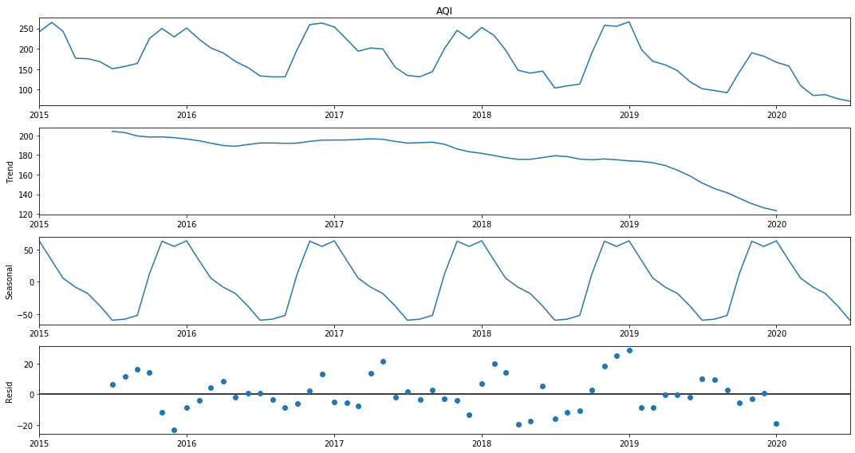
Decompose of Time Series
Time-series decomposition that allows us to decompose our time series into three distinct components: trend, seasonality, and noise.

Slide 15
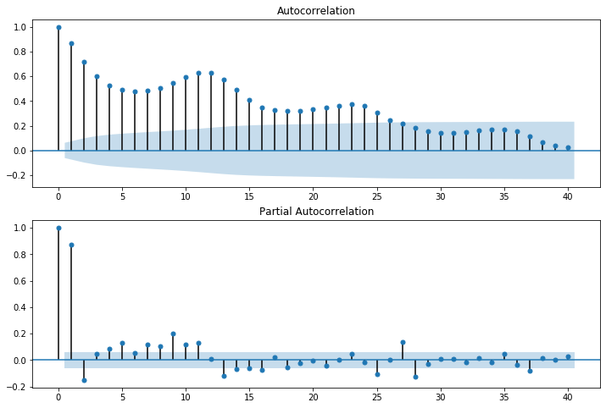
ACF and PACF
ACF is an (complete) auto-correlation function which gives us values of auto-correlation of any series with its lagged values.
A partial autocorrelation is the amount of correlation between a variable and a lag of itself that is not explained by correlations at all lower-order-lags
Partial autocorrelation computes the "pure" correlation between xt and xt−2 by removing the "transitive" correlation, that is, the amount of correlation explained by the first lag, and recomputing. For the partial autocorrelation between xt and xt−3, we will remove the correlation with both xt−1 and xt−2 and recompute, and so on.

Slide 16
Steps in Model Building
Reading and Understanding the Data Set
Exploratory Data Analysis
(Imputing Null Values, Outlier Detection, Visualisation)
Building a base model using ARIMA and finding the least AIC Values
Building a model using Auto ARIMA and finding the order which gives the least AIC Value
Improving the RMSE and MAPE using SARIMAX, VAR and LSTM for month, week, day wise predictions.

Slide 17
AUTO ARIMA MODEL FOR DATA MONTH WISE
Auto Arima for Data Month Wise
Auto Arima Model finds out the best features and builds an ARIMA model.
It calculates the lowest AIC value amongst a combination of orders of (p,q,d)
ARIMA(1,1,1) gives an AIC of 8889 where as Auto Arima finds the best order (3,0,2) gets the lowest AIC of 496
Interpretations:
Auto arima is used for finding best order for ARIMA.
Its also gives the seasonality, but in ARIMA we don't required.
ARIMA(3,1,3) gives good result than the ARIMA(1,1,1), its gives less AIC value compare to first model.

Slide 18
AUTO ARIMA MODEL FOR DATA WEEK WISE
Auto Arima for Data Week Wise
According to the ARIMA for data Week Wise
ARIMA(2,0,0) gives an AIC of 2070.
The AIC is even lesser as compared to the AIC of Month wise ARIMA Model.

Slide 19
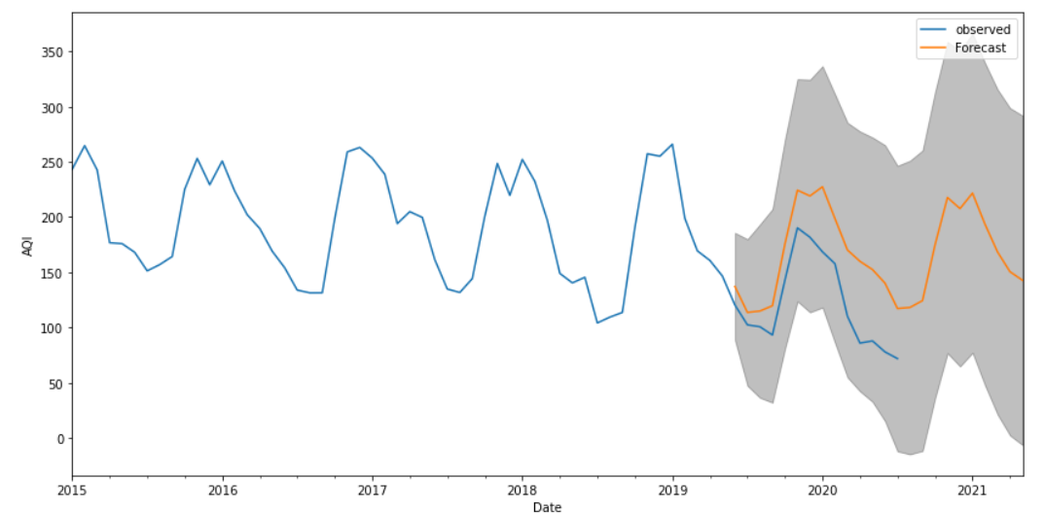
SARIMAX MODEL FOR MONTH VS WEEK WISE
SARIMAX model adds seasonality to the ARIMA Model.
Interpretations:
Blue Line is the observed value
Orange Line is the forecasted values
Grey area is the confidence interval at 95%

Slide 20
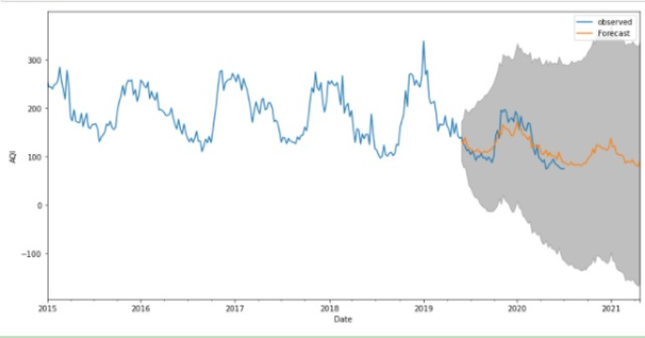
SARIMAX MODEL FOR WEEK WISE
Interpretations:
Blue Line is the observed value
Orange Line is the forecasted values
Grey area is the confidence interval at 95%

Slide 21
Vector Auto Regression (Multivariate Analysis for Month Wise)
VAR is similar to the AR and MA models the only difference that AR and MA are used for univariate analysis where as VAR is a multivariate analysis.
The AR and MA models are unidirectional and VAR model is a bidirectional model.
The algorithm calculates the vectors of the coefficients and multiplies it to the vectors of (t-1)value and adds the vectors of errors to it.
It gives us the RMSE and MAPE for all the variables.

Slide 22
Conclusions
According to the heat map PM2.5, PM10, CO have a high correlation with AQI meaning when AQI is higher the level of these gases present in the air is higher.
According to the city wise average graph we see that Ahmedabad has the highest AQI. This is an indication to the state authorities to take measures to reduce the pollution levels in the city
Statistical Tests were run on the variables and on the basis of p-values we can conclude that CO, NO2, PM2.5 SO2 are highly significant variables.
Predicted AQI for 2020 was very high based on past years. But actual AQI is low. The reason for this was the impact of Covid 19. The whole nation was on lockdown and movement of people or vehicle was restricted. Hence the AQI levels went down.
We have done a Univariate and Multivariate analysis on AQI.
Univariate Analysis is done by using ARIMA, Auto-ARIMA and SARIMAX models.
Multivariate Analysis is done by using VAR model.
We have received the best results for predicting AQI through SARIMAX, therefore we chose SARIMAX as our final model and the forecasted values are visualized through graphical representation.
From the forecasted graph we can conclude that AQI will be high for coming year 2021. The focus should be on how the pollutants affecting AQI can be reduced.

Slide 23
THANK YOU

